Slide 1
Global Financial Markets and Products
Dr. Sarveshwar Kumar Inani
sarveshwarinani@wilp.bits-pilani.ac.in
Notes:
Lecture 1.4-HM

Slide 2
Agenda
Mention the books in new outline
Recap of session 1 PPT
Overview of Financial intermediaries and institutions
Overview of Financial products

Slide 3
Why study Financial Markets and Institutions?
Financial markets (Stock market, bond market) are the places where short- and long-term source of finance are traded. Investors can invest, and individuals/ corporates/ governments can procure funds.
Financial institutions and intermediaries help in channelizing funds from surplus units to deficit units by creating various debt/equity instruments of direct and indirect investing.
Financial markets and institutions are responsible for:
Business growth, employment creation, and consumption
Production of good and services
Capital formation and growth of economy
Wealth creation in economy, and much more

Slide 4
Financial Institutions
Financial institutions: banks, finance companies (NBFCs), insurance companies (life and general both), mutual funds, investment banks, pension funds, investment advisory firms, brokers, wealth managers, among others. (All are highly regulated by government)
The prominent financial institution in financial system is central bank (RBI in India, Fed in US), which controls the interest rates and money supply in economy using monetary policy (policy rates). Monetary policy have a major impact on interest, inflation, business cycles, job market, which ultimately impacts the financial markets and institutions.
If not regulated, financial crisis may occur, and investors may lose credibility in the financial system. For example, 2008 financial crisis led to demise of Bear Stearns and Lehman Brothers (top investment banks in USA).

Slide 5
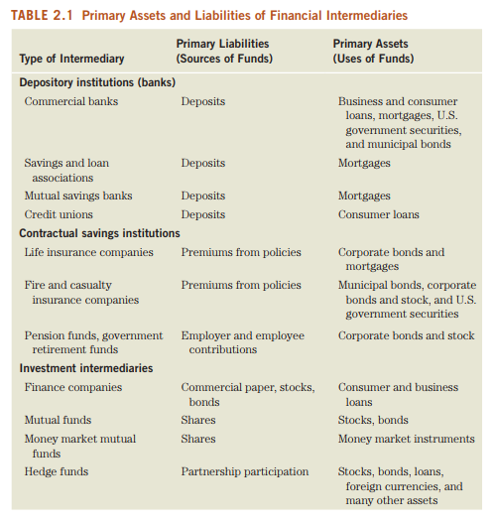

Slide 6
Financial Institutions…
International financial system: The financially integrated economies across the world has huge impact on domestic economies. Understanding forex market, trade sanctions, role of international bodies (IMF, World bank), etc. play a huge role in financial system of any economy.
Financial innovation: ATM, UPI, Cardless withdrawal, internet banking, NEFT, RTGS, ASBA, peer-to-peer lending, ETFs (equity, debt, gold, silver), mortgage-based securities (MBS), CDS, ADR, GDR, among others.
Risks in financial institutions: Fluctuating interest rates in bond market (Silicon Valley Bank), stock market crashes, crisis due to speculation in forex market, failure of financial institutes in crises. Hence, managing risk is crucial in financial institutions.

Slide 7
Managerial reasons to learn about Financial institutions
Financial institutions are the largest employer (with higher salaries) in the economy. Hence, understanding them becomes crucial.
Understanding them is important because you invest your hard-earned savings using their financial instruments.
Understand problems of financial institutions which you may face as a manager. Like: Development of a new financial product, risk management, etc.

Slide 8
Financial Markets: Classifications
Type of securities: Debt v/s Equity Market
Maturity: Money market v/s Capital market
Based on issue time: Primary v/s secondary
Cash Market v/s Derivatives Market (Futures, forwards, options, and swaps)
Organisational structure and regulation: Regulated exchange v/s unregulated/less regulated over the counter market

Slide 9
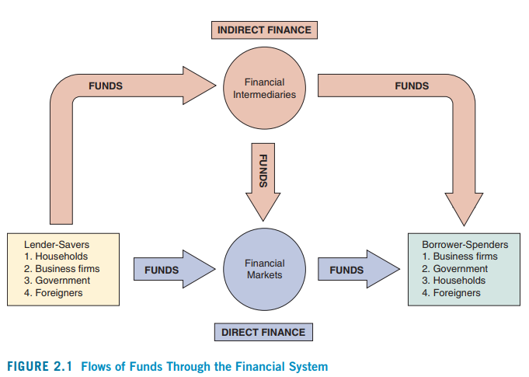
Flow of funds in financial system

Slide 10
Internationalisation of financial markets
Because of deregulation, advanced technology, increased participation of institutes, high speed internet, the world has become an integrated financial market.
Globalisation improves portfolio diversification for individuals/institutes
Globalisation may offer reduced cost of capital for corporates, especially while raising substantial amount.
Systematic risk of spread of financial crisis among financial institutions across international financial markets which can lead to collapse of financial system. For example, during 2008 sub-prime financial crisis, many financial institutions affected and collapsed (Issuer of security, buyers of security, real estate sector companies, stock market collapse, loss of wealth of FII/DII/retail who invested in stock markets).

Slide 11
International bond market
Foreign bonds
Foreign bonds are sold in a foreign country and are denominated in that country’s currency.
For example, if the German automaker Porsche sells a bond in the United States denominated in U.S. dollars, it is classified as a foreign bond.
Foreign bonds have different names in different countries. For instance, they are:
Yankee bonds in the United States
Samurai bonds in Japan
Bulldog bonds in the United Kingdom
Kangaroo bonds in Australia
Panda bonds in China

Slide 12
International bond market…
Eurobonds
A more recent innovation in the international bond market is the Eurobond, a bond denominated in a currency other than that of the country in which it is sold (generally denominated in USD).
For example, a bond denominated in U.S. dollars sold in London.
If a Eurobond is denominated in US dollars, then it can be called a euro-dollar bond.
Please note that the term “Eurobond” refers only to the fact that the bond was issued in a different country or currency. It does not need to be a country in Europe. The word Euro here has nothing to do with the currency of European Union, Euro. Eurobond market initially emerged in the 1960s in Europe.
Benefits to issuers: access to international markets, choose a favorable country with lower interest rate or less regulations, avoiding currency risk, financing global operations of MNCs, diversification of fundings.
Benefits to investors: diversification by investing in other currency investments, high liquidity, higher return.
Resource: https://www.wallstreetmojo.com/eurobond/

Slide 13
International bond market…
Eurobond example:
An Indian company wants to expand operations in Canada and needs Canadian dollar for this expansion plan. The interest rate in Canada is 6% p.a., which is quite high. Then he discovers that Canadian immigrants are living in Japan and have Canadian dollars in their account. Hence, Indian company issues Eurobond (denominated in Canadian dollar) in Japanese market where the interest rate is only 2%.
The Eurodollar bond market is one of the largest capital markets in the world, with an estimated outstanding volume of over $13 trillion.

Slide 14
International bond market…
Eurocurrencies
Eurocurrency is currency held as deposit outside its home market, i.e., held in banks located outside of the country which issues the currency. For example, U.S. dollars deposited in foreign banks outside the United States or in foreign branches of U.S. banks. Eurocurrency is an important part of the global financial system.
The dollars held outside the United States are referred to as Eurodollars. A deposit denominated in Japanese yen held in a Swiss bank is a Euroyen deposit.
Because these short-term deposits earn interest, they are like short-term Eurobonds (Money market).
In the Eurocurrency market, interest rates paid on deposits are typically higher than on the domestic market.
Eurocurrency is used for short-to-medium term financing by banks, multinational corporations, mutual funds, and hedge funds due to lower regulations.
On the downside eurocurrency markets are facing higher risks (No insurance of deposits, no govt. protection).

Slide 15
International Stock Market (Benchmark Indices)
Market efficiency and behavioural finance concepts
Nifty (50 stocks) and Sensex (30 stocks) (India)
Dow Jones Industrial Average (DJIA): 30 largest companies in USA
S&P 500: 500 largest companies in USA
NASDAQ 100: 100 largest non-financial companies listed on the Nasdaq stock exchange USA (Most are technology stocks).
FTSE 100: United Kingdom's best-known stock market index (London stock exchange)
DAX: 40 major German blue-chip companies trading on the Frankfurt Stock Exchange (Germany).
CAC 40: French stock market index made of 40 largest French stocks
Hangseng: Stock market index in Hong Kong (82 stocks).
Nikkei: Stock market index for the Tokyo Stock Exchange (225 stocks) in Japan.

Slide 16
Next class
Time Value of Money
Discounting
Compounding
Annuity, Annuity Due
Perpetuity

Slide 17
Thank You!

